Slide 1
Hackathon Presentation
ETL VALIDATOR
DATA MINERS
10/16/2020

Slide 2

Agenda
Team
Technology
Bus. Problem/Demo
Questions?

Slide 3
Team
Name | Role
Jaydeep Mahajan | Team Lead
Rachit Vijay | Technical Architect
Vishy Nandanavanam | Technical Director
DATA MINERS

Slide 4


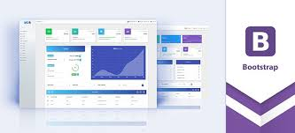


Technology
Java Enterprise
AWS, MYSQL, POSTGRES, Possible Multi-databases, GITHUB
REACTJS, JOOQ, JAVA, SQL, MD-BOOTSTRAP, SPRING-BOOT
Dynamic SQL Query building using JOOQ

Slide 5
Business Problem Addressed /Demo
The ETL Validation teams usually works on tools that reduces the time of operation but lacks the in-depth Quality check or write complex code to keep quality of the data consistent as per the business rules, which is time consuming, prone to errors and require multiple iterations to get to right point.
Currently there are several tools in the market that perform “Data Migration Check” but either they are too expensive or doesn’t handle all the complex scenarios such as transformation, heterogeneous data base sources, custom complex queries etc.
Whether we do one-to-one mapping DQ check or include complex transformation, we do write complex code to compare the data which is time consuming and prone to errors. If we can build a UI based solution that can be operated by non-technical person and can handle most of the simple scenarios of DQ process such as one-to-one comparison. We can save a lot of hours that can be invested in more complex tasks.
For many-to-many mapping rules, complex queries are needed to be performed and this tool provide an extension to that solution. We can handle complex joins with this tool.

Slide 6
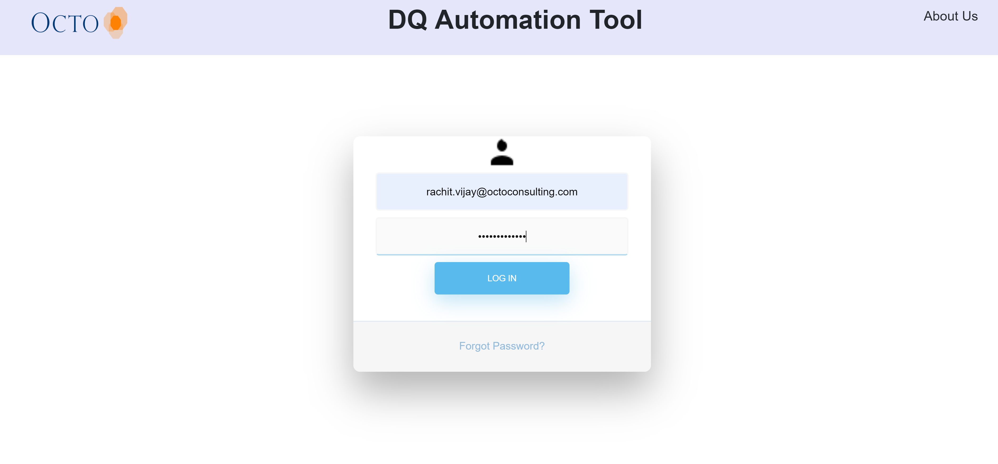
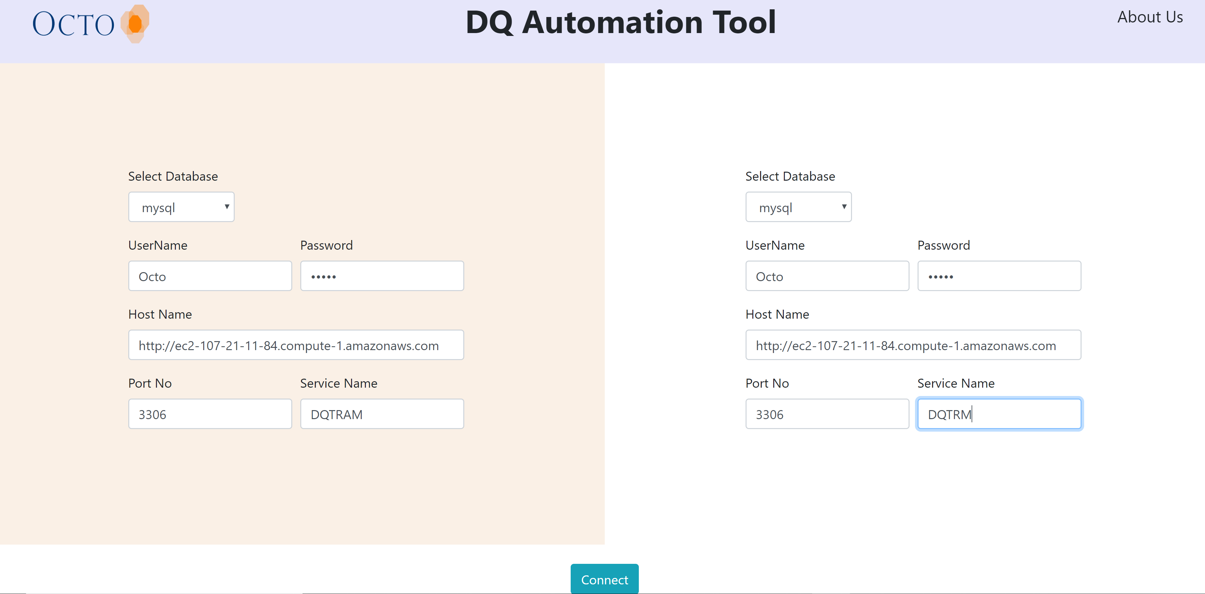
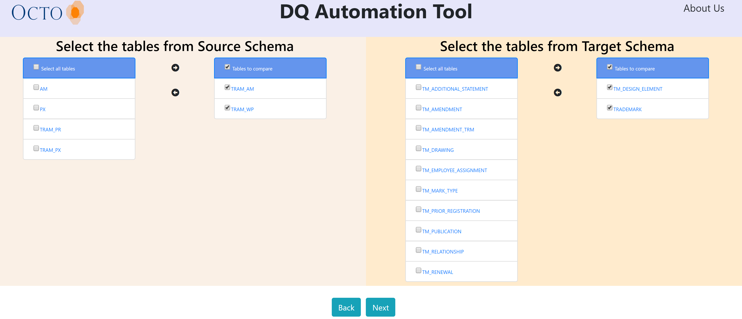
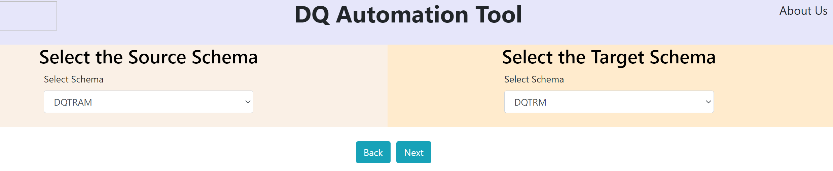
DEMO SCREENSHOTS
LOGIN PAGE

Slide 7
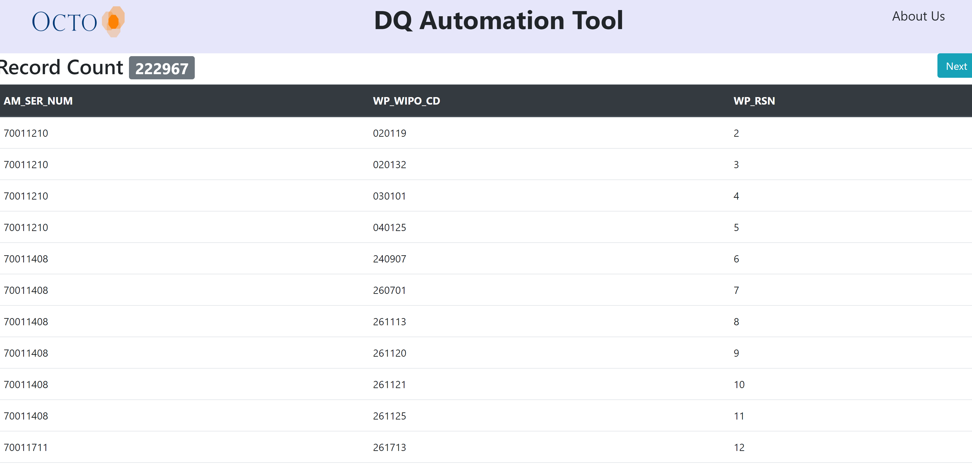
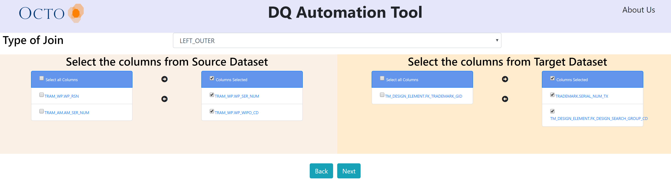
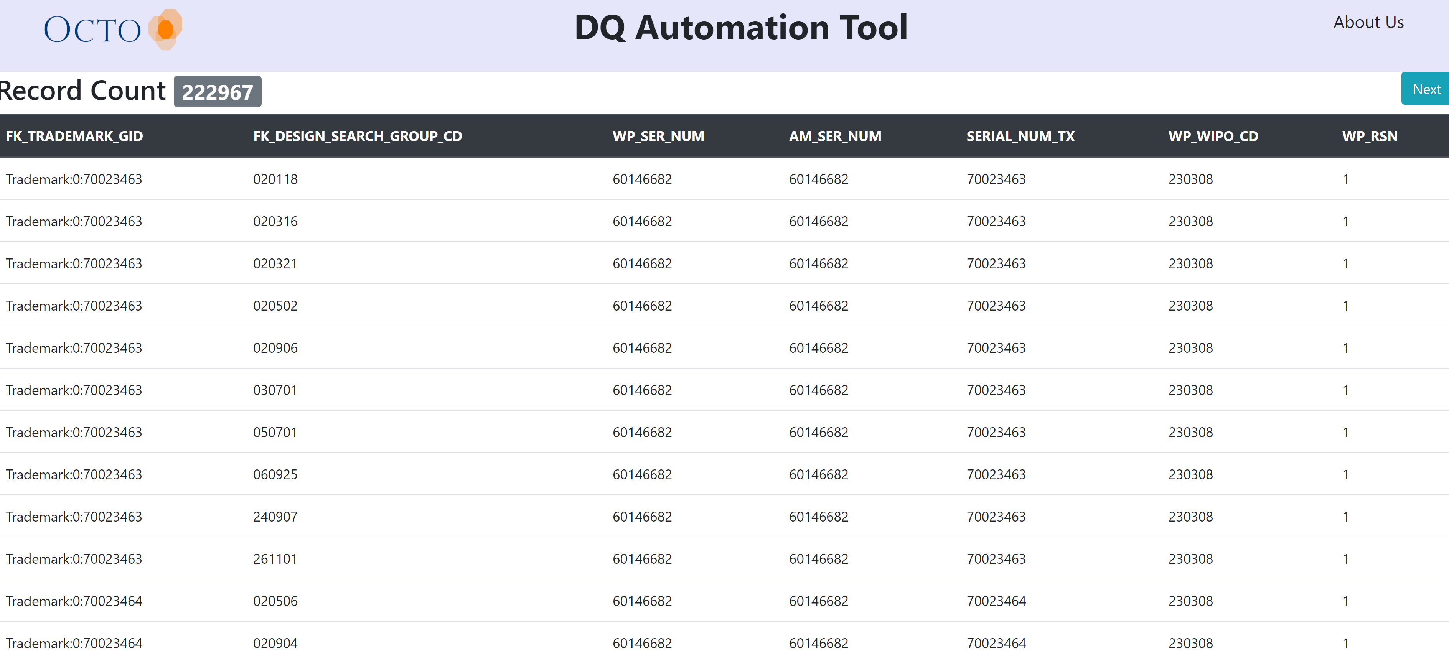
DEMO SCREENSHOTS
Live Demo

Slide 8
FUTURE IMPROVEMENTS
Support to select custom transformations from UI.
Data Export functionality
Custom SQL via UI.
Share results via email.

Slide 9

Questions?

Slide 10

www.linkedin.com/company/octo-consulting-group
https://www.facebook.com/OctoConsulting
www.twitter.com/octoconsulting

